Slide 1
Shape of moving chromosomes in fission yeast
Wenwen Huang
27.04.2015

Slide 2
Outline
Background Reminder
Results
TODO

Slide 3
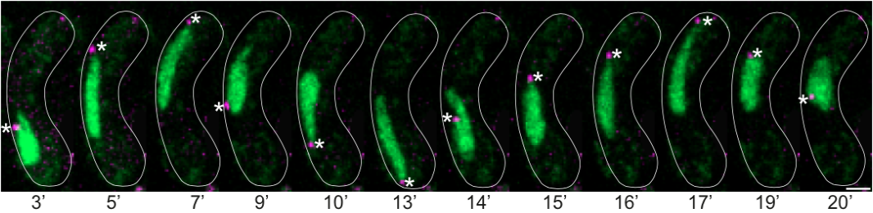
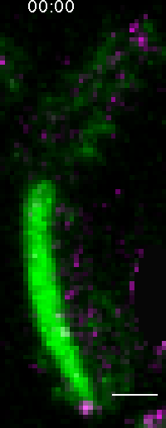
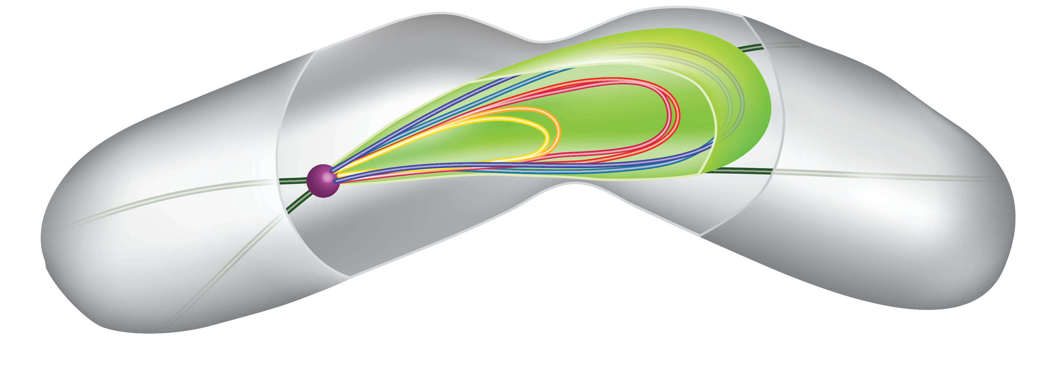
Nuclear Oscillation in Fission Yeast (S. pombe)
Time-lapse experiments of zygotes expressing Rec8 tagged with GFP (DNA marker in green) and Sid4 tagged with mCherry (SPB marker in magenta, stars). Note, the nucleus alternates round and elongated shapes during the oscillations accordingly to the SPB position. Scale bar=2µm, time in minutes.
DNA marker in green
SPB (Spindle Pole Body) marker in magenta
Shape of Chromosomes <=> Biological function (Spherical/elongated) (Recombination)

Slide 4
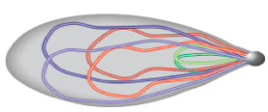
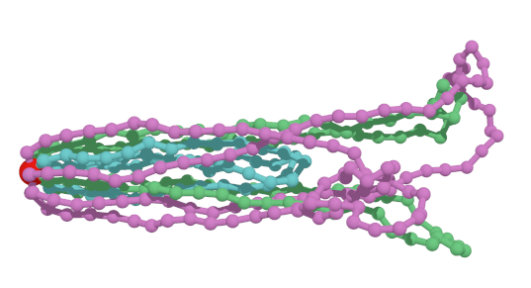
Model chromosome by polymer loops
Chromosomes in nucleus
Bead-rod polymer ring
Consider constant moving velocity for simplest modeling

Slide 5
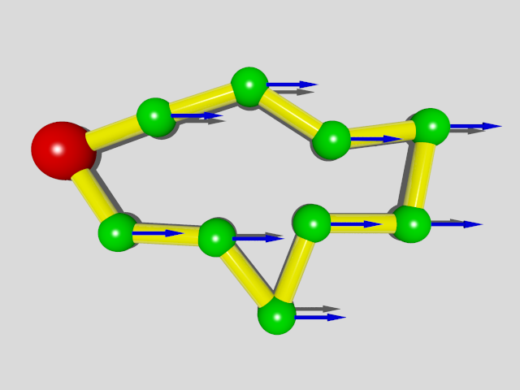
Pinned polymer loop
Bead:
position ----
Rod:
length ---
Results we already have:
Mean position:
Position covariance:

Slide 6
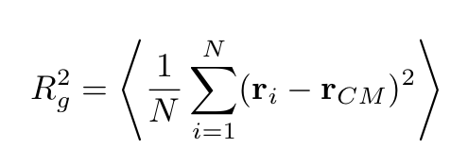
Characteristic quantities
Gyration radius:
Gyration tensor:

Slide 7
Characteristic quantities
Gyration tensor based measure:
Normalized to [0,1]
Asphericity
the nature of
asphericity
Normalized to [-1,1]
J. W. Cannon, J. Phys. (1991)
Karen Alim & Erwin Frey, PRL (2007)

Slide 8
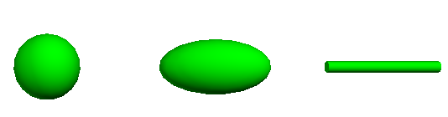
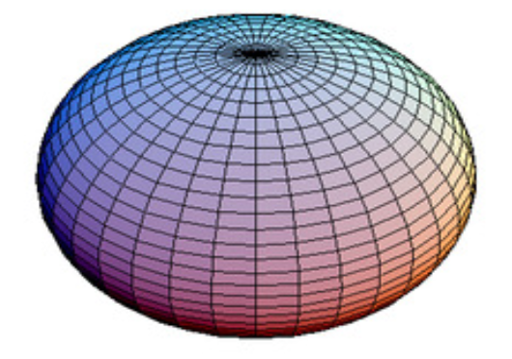
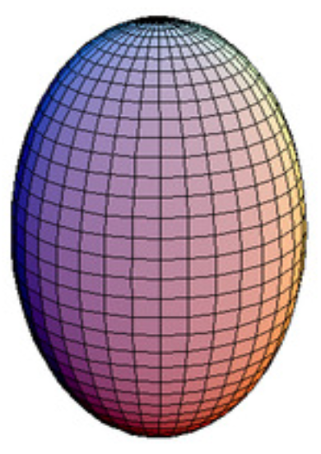
Asphericity & the nature of asphericity
Asphericity:
0
1
the nature of asphericity:
-1
+1

Slide 9
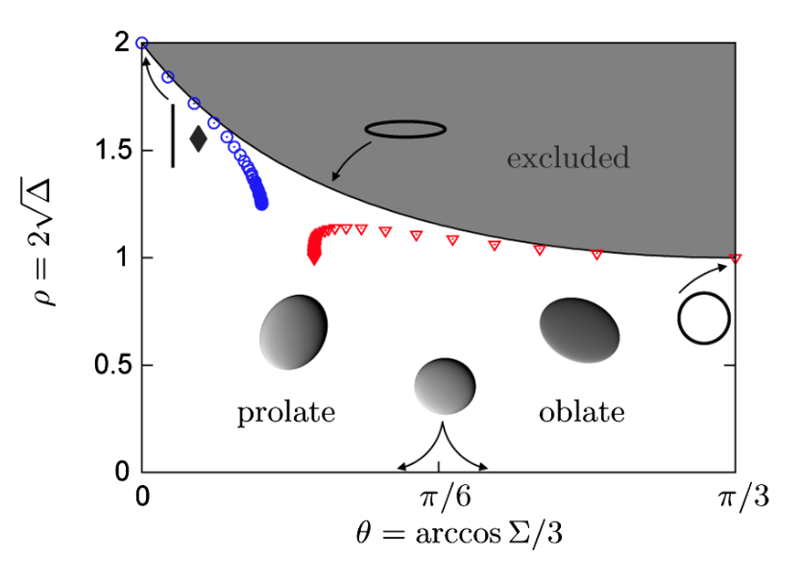
Asphericity & the nature of asphericity
Karen Alim & Erwin Frey, PRL (2007),

Slide 10
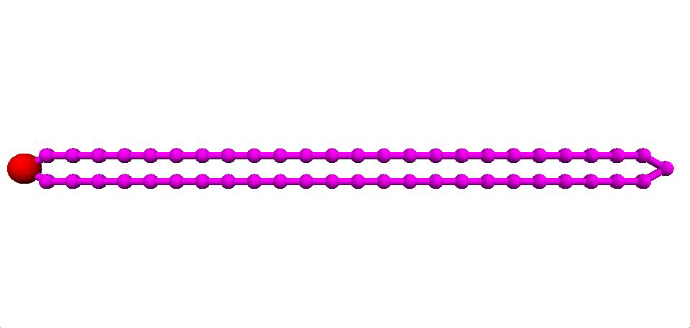
Monte-Carlo Simulation (T = 1, N =50)

Slide 11
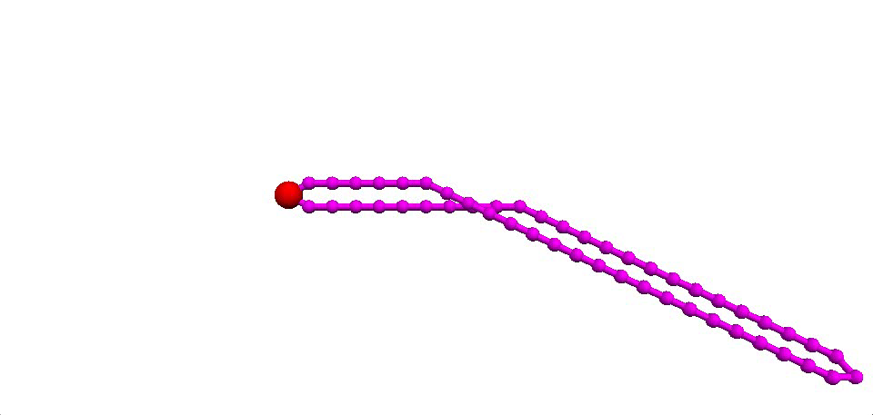
Monte-Carlo simulation (T=10000, N =50)

Slide 12
Gyration Radius (N=100)

Slide 13
Gyration Radius (N=100)
Notes:
----- Meeting Notes (13/04/15 10:54) -----
check gaussian ring limit

Slide 14
Asphericity & the nature of asphericity

Slide 15
Gyration Radius (N=100, with excluded volume)

Slide 16
Asphericity & the nature of asphericity

Slide 17
Gyration Radius (multiple rings)

Slide 18
Asphericity & the nature of asphericity

Slide 19
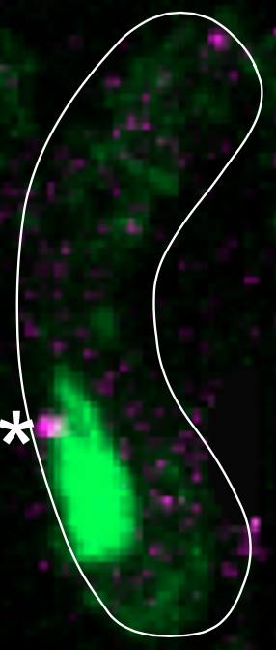
TODO
Symmetric break for pinned polymer loop
Ellipsoid Fit
Cone Fit ?
Oscillation force field --- turning over shape

Slide 20
All suggestions and comments
are greatly appreciated!
Thank you!

Slide 21
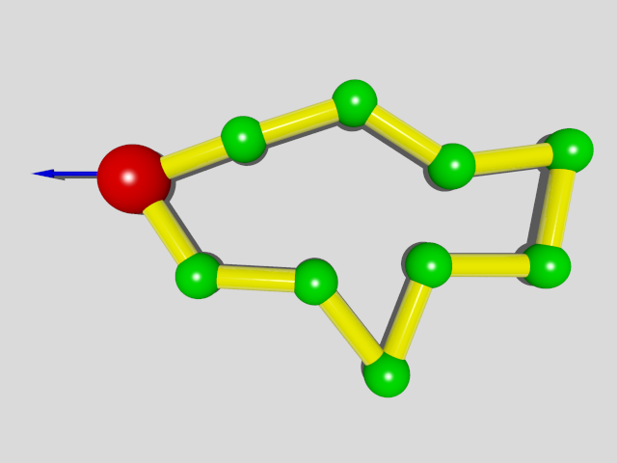
Theory for 1D model
Transfer to co-moving frame:
Constant driven force on SPB
Constant force field and pinned SPB
For 1D system:
Loop Constraint:

Slide 22
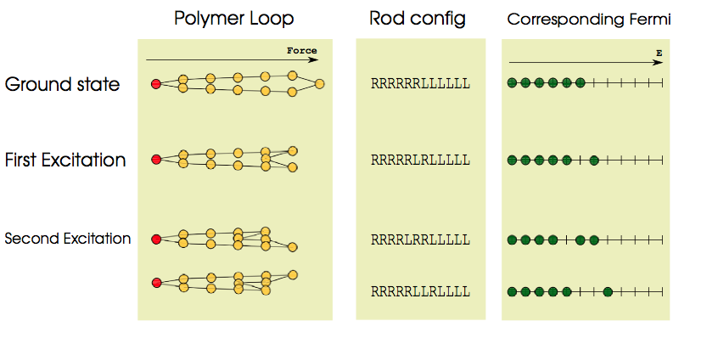
Theory for 1D model
Hamiltonian:
Equivalent to N/2 Fermions in N energy levels

Slide 23
Theory for 1D model
Partition function
By setting natural temperature unit
Fermi-Dirac distribution
Statistical Results

Slide 24
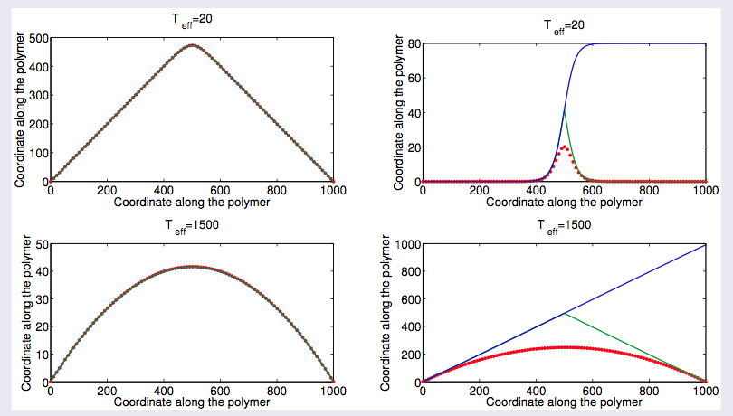
1D Theory

Slide 25
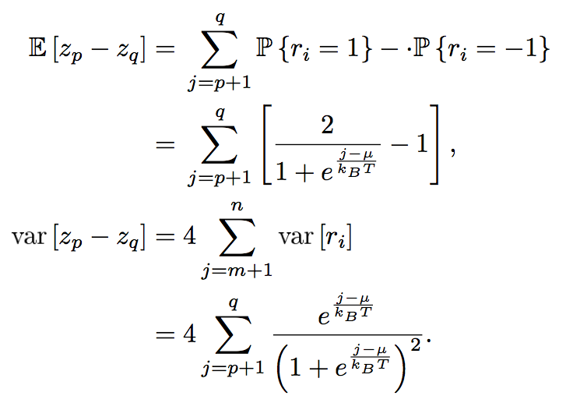
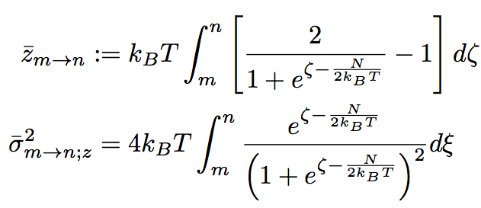
Brownian Bridge Approach
--- devise an effective stochastic process satisfies Z_{N}= Z₀
Step 1: construct effective process:
Z₀ = 0;
Z_{l} is almost surely continuous;
Z_{l} has independent increments;
Where the mean and the variance is determined by:

Slide 26
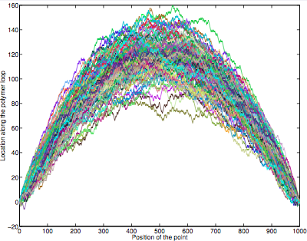
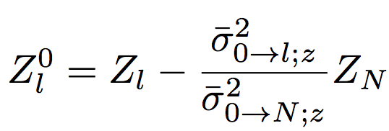
Brownian Bridge Approach
--- devise an effective stochastic process satisfies Z_{N}= Z₀
Step 2: introduce loop condition
Construct conditional process:
where

Slide 27
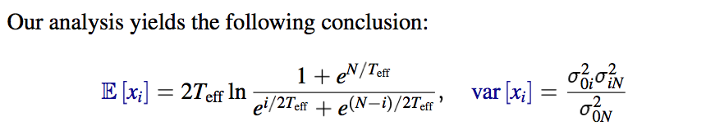
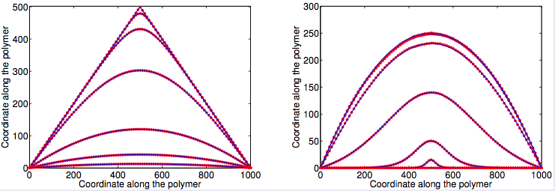
Numerical Verification of 1D model

Slide 28
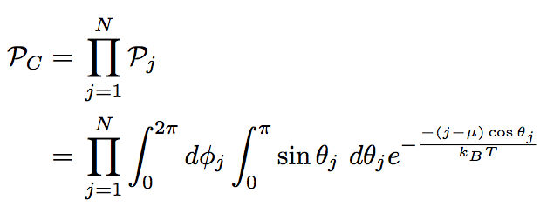
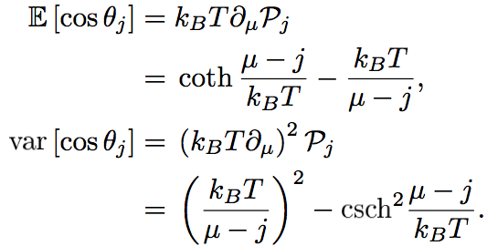
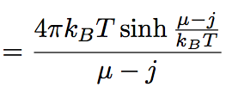
3D Continuous Model
Hamiltonian
Heisenberg model
Partition function

Slide 29
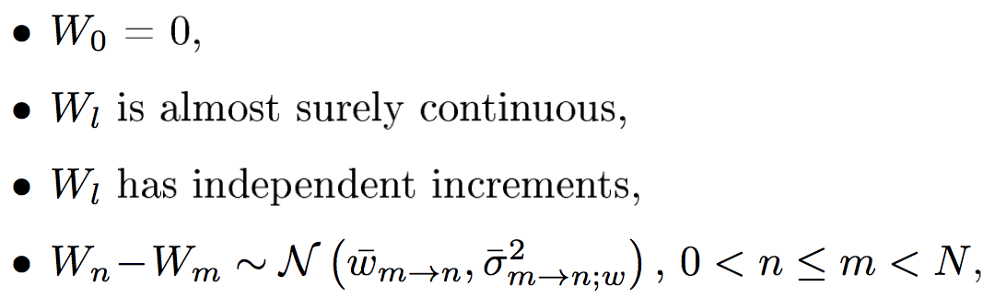
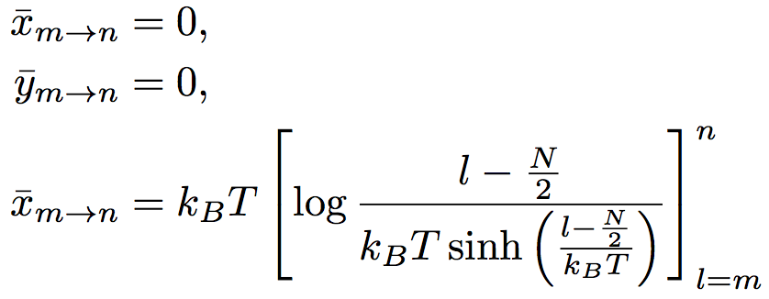
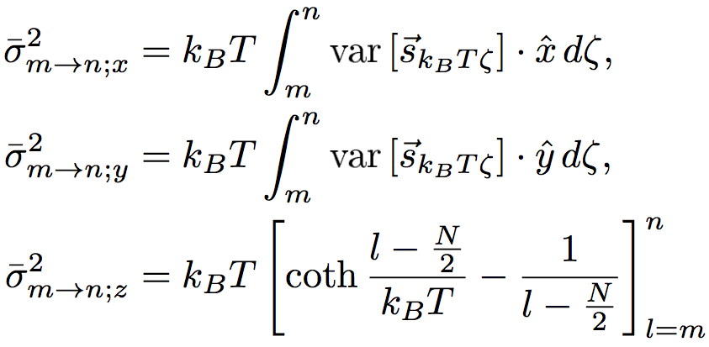
Adopt Brownian Bridge Approach
Define Effective 3D stochastic process:
Conditional effective process:

Slide 30
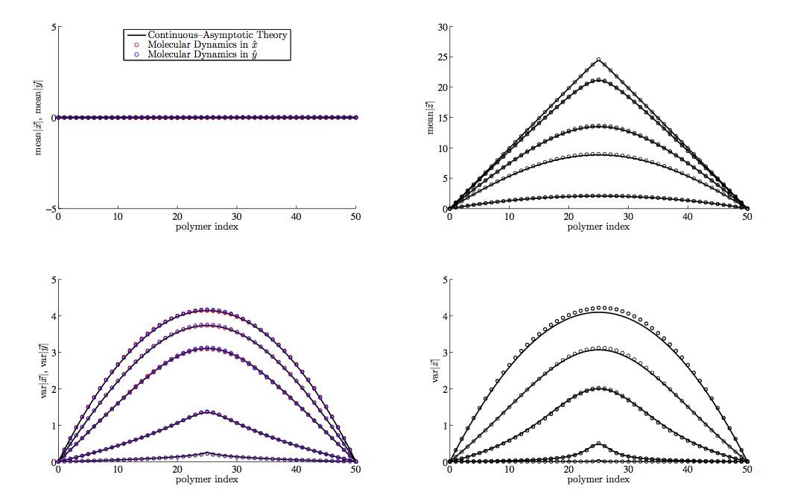
Numerical Verification of 3D model

Slide 31
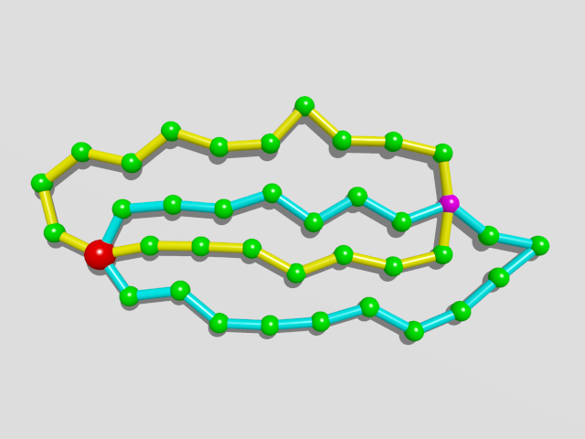
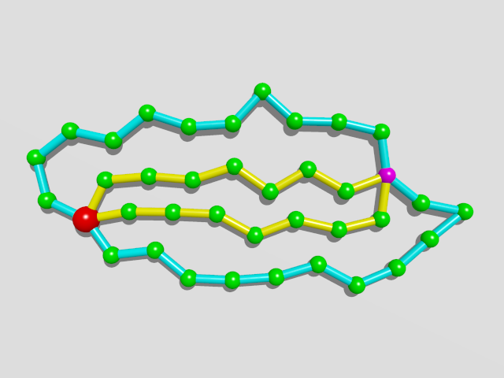
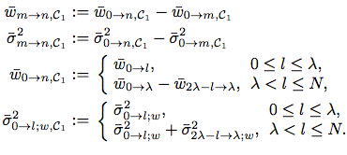
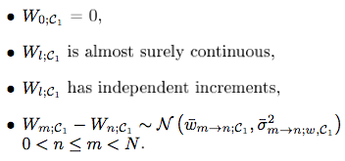
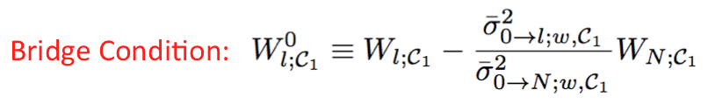
A Pair of Rings with Centromere
Re-label the loops
Brownian Bridge

Slide 32
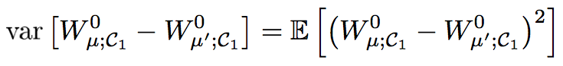
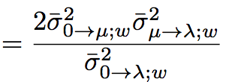
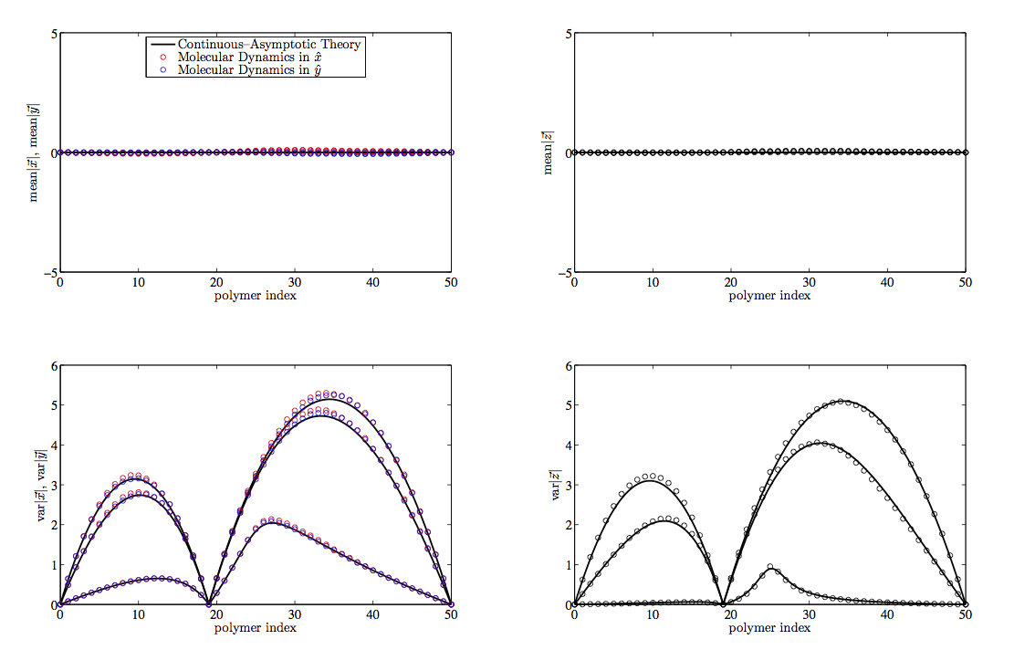
Numerical Verification
Theoretical Result

Slide 33
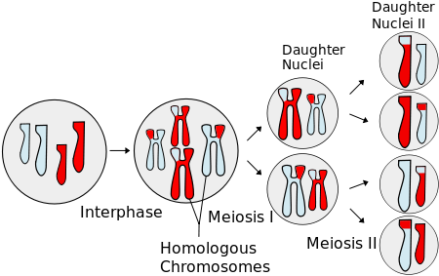
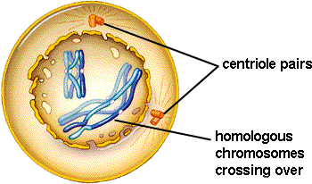
Meiosis
Prophase I
Chromosome movements
Pairing
Recombination

Slide 34
Brownian Dynamics:
Inertia-less assumption
is the index of bead
is hydrodynamic force
represents force generate from potential
is constraint force to keep the rod length
is brownian force
is external force

Slide 35
Brownian Dynamics:
Dynamical differential equation:

Slide 36
Numerical Scheme
Predictor-corrector algorithm:
Step 1: predict using known forces
Step 2: correct using constraint force
(*)
Step 3: substitute eq. (*) to constraint equations
Solve a set of nonlinear algebraic equations
Step 4: re-substitute to (*) obtain the final

Slide 37
Parameter Estimation
Length of Chromosomes in base pairs:
There are 3 pairs of chromosomes in prophase fission yeast
Chromosome I: 5.579.133 bp ~ 5,6Mbp
Chromosome II: 4.539.804 bp ~ 4,5Mbp
Chromosome III: 2.452.833 bp ~ 2,5Mbp
Compaction ratio of chromosomes: ~ 100bp/nm
Kuhn length(rod length): ~ 100nm
System size for 3 pairs of chromosomes: ~ 2000-3000
monomers in one ring : 200 ~ 600

Slide 38
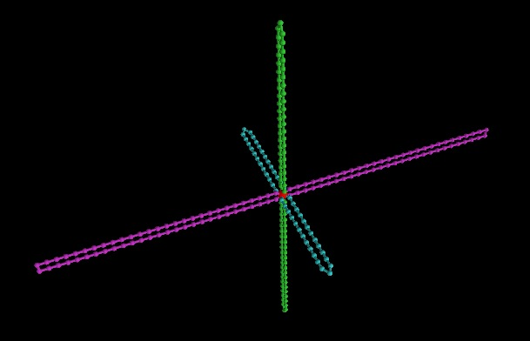
Initial configuration

Slide 39
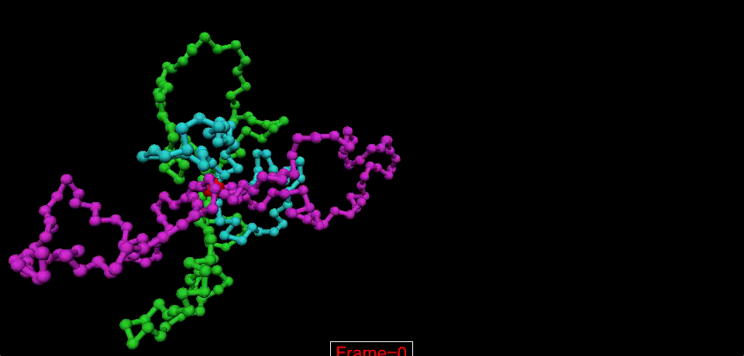
Animation Movie

Slide 40
Problem
Toy model with 100 beads
Real System
Solution:
Parallel computation

Slide 41
Ways to go
Use some kinds of sophisticated MD packages
Advantage:
easier to go, parallelize automatically
Disadvantage:
cannot control some details, e.g. random force
not so flexible
Write a parallel program
Totally under control but need more time on technique details
My Strategy
Doesn’t work
Write a parallel program
Try MD packages

Slide 42
List of MD packages
http://en.wikipedia.org/wiki/List_of_software_for_molecular_mechanics_modeling
Rules of selection
No commercial, should be free
Need GPU acceleration
Widely used
Selected packages:
Gromacs
LAMMPS
ESPResSo

Slide 43
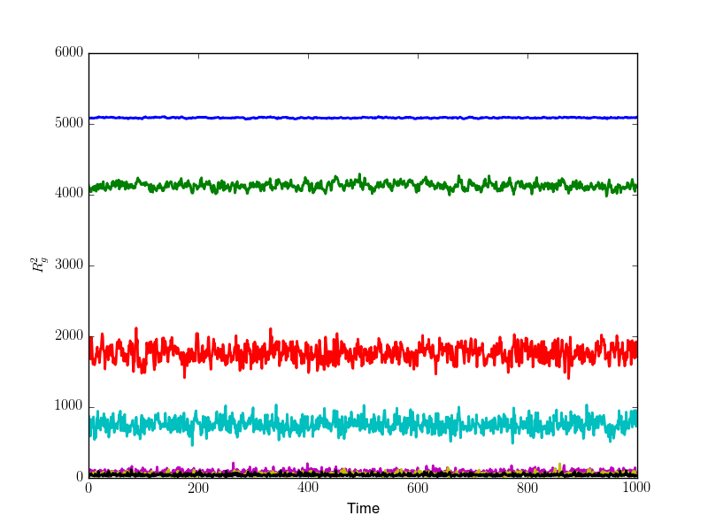
Results (N=500)

Slide 44
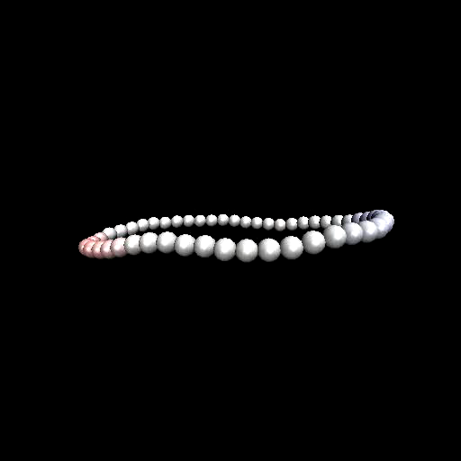
Tumbling dynamics
Philipp S. Lang etal. Phys. Rev. E 89, 022606 (2014)

Slide 45
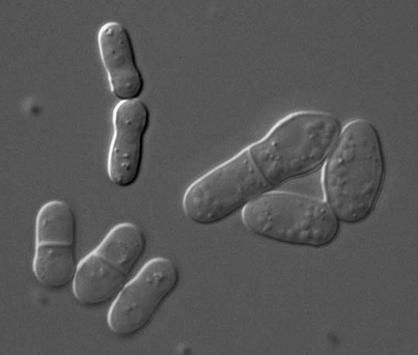

Fission Yeast( S. pombe)
Sketch of fission yeast
during cell division
Rhind N et al. Science. April 21, 2011

Slide 46
Chromosome Movement ( S. pombe)
3 pairs of chromosomes
Telomere bond to SPB
Oscillation is driven by SPB
In the mean time:
Homologous chromosomes
paring and recombination
Chikashige et al., Science 1994
Yamamoto et al, JCB 1999
Ding et al., DevCell 2004

Slide 47
Model chromosome by polymer loops
One Chromosome is represented by a polymer ring with the driven bead be the SPB(spindle pole body).
co-moving frame

